Slide 1

Welcome to
Final Presentation

Slide 2
Analysis On Healthcare Datasets Using Machine Learning Algorithm
Group 31
RAJAN SHARMA (181500543)
ISHANT GOYAL (181500242)
DEEPAK AWASTHI (181500202)
Under the Guidance of
Dr. Saroj Kumar Pandey
(Assitant Professor)

Slide 3
Introduction
Machine learning algorithms can detect patterns associated with diseases and health conditions by studying thousands of healthcare records and other patient data.
Using the past health records of the patients, the concept helps to predict their future state of health. It enables medical professionals to allocate resources on time to reduce the mortality rate.
Machin Learning will soon get integrated into practice as a diagnostic aid, particularly in primary care. It plays a crucial role in shaping a predictive, personalized, and preventive future, making treating people a breeze.

Slide 4
Algorithms Used
Support Vector Machine (SVM)
Random Forest Classifier
K-Nearest Neighbours
Naive Bayes Classifier

Slide 5
Datasets Used
Wisconsin Breast Cancer
Pima Indians Diabetes
Kidney Diseases Dataset
Heart Disease dataset
We have taken datasets from UCI and Kaggle

Slide 6
Support Vector Machine
Support Vector Machine or SVM is one of the most popular Supervised Learning algorithms, which is used for Classification as well as Regression problems.
The goal of the SVM algorithm is to create the best line or decision boundary that can segregate n-dimensional space into classes so that we can easily put the new data point in the correct category in the future. This best decision boundary is called a hyperplane.
SVM chooses the extreme points/vectors that help in creating the hyperplane. These extreme cases are called as support vectors, and hence algorithm is termed as Support Vector Machine.

Slide 7

Graphical Representation(SVM)

Slide 8
Random Forest Classifier
Random Forest is a popular machine learning algorithm that belongs to the supervised learning technique. It can be used for both Classification and Regression problems in ML.
It is based on the concept of ensemble learning, which is a process of combining multiple classifiers to solve a complex problem and to improve the performance of the model.
Random Forest is a classifier that contains a number of decision trees on various subsets of the given dataset and takes the average to improve the predictive accuracy of that dataset.

Slide 9
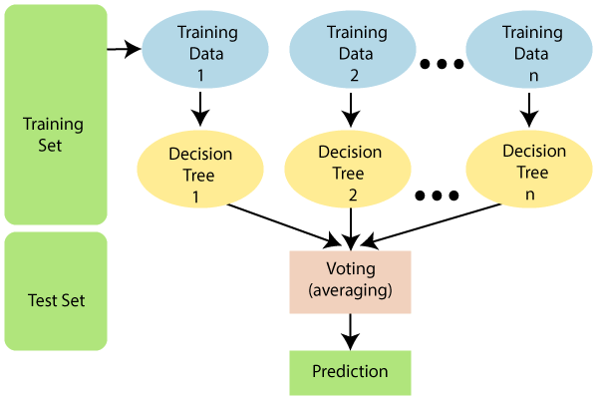
Pictorial Representation(SVM)

Slide 10
K-Nearest Neighbour
K-NN algorithm assumes the similarity between the new case/data and available cases and put the new case into the category that is most similar to the available categories.
K-NN algorithm stores all the available data and classifies a new data point based on the similarity. This means when new data appears then it can be easily classified into a well suite category by using K- NN algorithm.
It is also called a lazy learner algorithm because it does not learn from the training set immediately instead it stores the dataset and at the time of classification, it performs an action on the dataset.

Slide 11
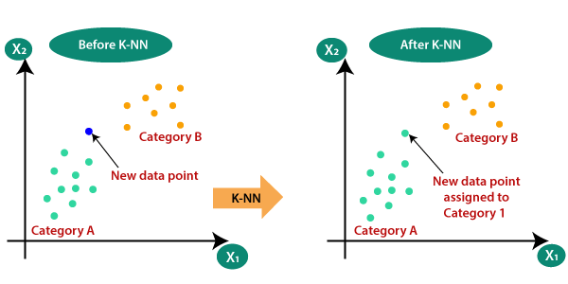
Graphical Representation(KNN)

Slide 12
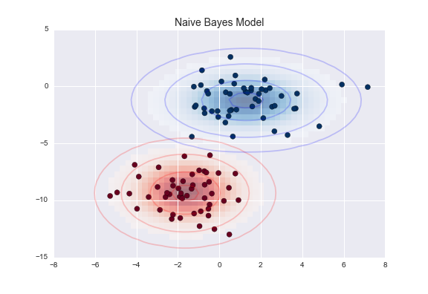
Naive Bayes Classifier
Naïve Bayes algorithm is a supervised learning algorithm, which is based on Bayes theorem and used for solving classification problems.
Naïve Bayes Classifier is one of the simple and most effective Classification algorithms which helps in building the fast machine learning models that can make quick predictions.

Slide 13
Future Scope
Doctors can understand the disease curing capability with use of machine learning on healthcare datasets.
Use of Machine Learning helps in easy prediction of disease.
Other datasets can also be used to find the model predicting diseases.
Web applications can be made which will benefit normal people understanding the severity of disease based on symptoms

Slide 14
Conclusion
We have worked on different algorithms and have achieved good accuracy which shows that the results predicted by the algorithms is nearly accurate and can be trusted.
Machine Learning is a very helpful technology which can solve various problems in healthcare.

Slide 15
Thank You!

